Slide 1


FUNCTIONAL
REACTIVE
PROGRAMMING
GETTING READY FOR
THE NEXT PROGRAMMING SHIFT
GETTING READY FOR
THE NEXT PROGRAMMING SHIFT

Slide 2
WHO I AM?
Sergi Dote Teixidor
Software Engineer
Front-end Lead Architect at
@sergidt
sergi.dote@fronttier.io
https://fronttier.io

Slide 3
Course path
Functional Programming
Reactive Programming
RP Exercises
Introduction
FP exercises
Functional Reactive
Programming
FRP Exercises

Slide 4

Used Technologies

Slide 5
Let’s start…
Are you ready?

Slide 6
What Functional Reactive Programming is?
FRP
Functional
Programming
Reactive
Programming
Notes:
In this slide there is a background placeholder. Click to the small icon on the center of the slide and choose an image from computer. When add an image, you must sent it to back with Right Click on Image -> Send to Back -> Send to Back.

Slide 7
λ
Functional Programming

Slide 8

FUNCTIONAL PROGRAMMING
The answer is…
Wait a moment…
I use functions,
I code classes and their behavior using methods,
then I master the FP!!
NOPE!!

Slide 9
FUNCTIONAL PROGRAMMING
Programming paradigm based on λ – Calculus:
“Treats computation as the evaluation of mathematical functions
and avoids changing-state and mutable data”
Functional Programming
Pure Functions
Function composition
Immutability
High Order Functions
Referential Transparency
Currying

Slide 10
FUNCTIONAL PROGRAMMING
Fat Arrow Notation
Allows us to codify functions following the λ – Calculus notation:
Normal notation Fat arrow notation

Slide 11
Functional Programming
PRINCIPLES
Notes:
In this slide there is a background placeholder. Click to the small icon on the center of the slide and choose an image from computer. When add an image, you must sent it to back with Right Click on Image -> Send to Back -> Send to Back.

Slide 12
FUNCTIONAL PROGRAMMING
Pure Functions
Given the same inputs returns the same output
Don’t mutate outer variables
Impure
Has zero side-effects
Are Simpler by definition
Pure
Are Simpler to test
Can be Memoized
Can invoke other pure functions

Slide 13
FUNCTIONAL PROGRAMMING
Function composition
Composition is the main operation in Lambda Calculus
Pure functions can be composed (chained) to get new functions
Allow us to build complicated data transformations from small pieces
Makes our code more reusable

Slide 14
FUNCTIONAL PROGRAMMING
Currying and Partial Function Application
A curryed function is a function that is invoked with fewer arguments than it was expecting
A curried function is partially applied when returns a new curried function expecting the remaining arguments
When all arguments are supplied, the function is invoked
const add = (x: number, y: number) => x + y;
const add = (x: number) => (y: number) => x + y;
//We can do:
add(1)(3); // => 4
// and:
const add10To = add(10);
add10To(5); // => 15
const add = (x: number, y: number) => x + y;

Slide 15
FUNCTIONAL PROGRAMMING
Referential Transparency
A pure function must be safely replaced by its expression without changing the program behavior
This can be especially helpful when reasoning about recursive functions
Helps providing the following benefits:
Correctness
Algorithm simplicity
Allows modify code without breaking it
Lazy evaluation
Memoization and common subexpression elimination

Slide 16
FUNCTIONAL PROGRAMMING
Immutability
A mutable object is any object which can be modified after it’s created
Immutability is a central concept of functional programming because without it, the data flow in your program is lossy, and strange bugs can creep into your software
Keeping in mind, we avoid Shared states, and Side effects

Slide 17
FUNCTIONAL PROGRAMMING
Shared State
Property of an object being passed between scopes
To understand the effects of a function, you have to know the entire history of every shared variable that the function uses or affects
Changing the order in which functions are called can cause a cascade of failures because functions which act on shared state are timing dependent
Remove function call timing dependency, and you eliminate an entire class of potential bugs
Avoid it!!

Slide 18
FUNCTIONAL PROGRAMMING
Side effects
In Imperative Programming Languages, side effects are everywhere
Variables can be changed anywhere in your program => bugs!!
Avoiding side effects, the program is much easier to understand, and to test
Keeping side effects separate from the rest of your program logic, software will be much easier to extend, refactor, debug, test, and maintain, your code will be loosely coupled
Avoid it!!

Slide 19
FUNCTIONAL PROGRAMMING
Higher Order Functions
Function is a first-class citizen, a function is just another value, then can be passed as parameters
Higher-order Functions either take functions as parameters, return functions or both
Are also known as operators: map, filter, find, reduce…
const items: Array<any> = [1, 2, 'a', null, false, 3, 5];
console.log(items.every(Number)); //output: false
console.log(items.some(Number)); //output: true

Slide 20
Let’s see important High Order Functions…

Slide 21
Map
FUNCTIONAL PROGRAMMING
applies a function f to each element in an array and returns an array of equal length.
output = [ , , … , , ].map(predicate);
Example
const squares = [1,2,3,4,5].map(x =>x * x);
squares = [1,4,9,16,25];

Slide 22
Filter
FUNCTIONAL PROGRAMMING
output = [ , , … , , ].filter(predicate);
Example
const oddNumbers = [1,2,3,4,5,6,7].filter(x =>x % 2 !== 0);
oddNumbers = [1,3,5,7];

Slide 23
Reduce
FUNCTIONAL PROGRAMMING
Compresses an array of items down to a single value. This value is computed invoking a function with an accumulator value against each item.
reduction function
[ , , … , , ].reduce((accumulator, currentItem) =>function, );
Initial value
Example
const value = [1,2,3,4].reduce((acc, cur) =>acc + cur, 0);
Step 1
Step 2
Step 3
Step 4
acc = 0;
acc = 1;
acc = 3;
acc = 6;
cur = 1;
cur = 2;
cur = 3;
cur = 4;
value
return acc + cur;
return acc + cur;
return acc + cur;
10
return acc + cur;

Slide 24
FUNCTIONAL PROGRAMMING
Other High Order Functions
find
some
every
forEach
findIndex
…
and your own

Slide 25
Functional Programming
Exercises

Slide 26
Reactive Programming

Slide 27
REACTIVE PROGRAMMING
Reactive Manifesto
Responsive: The system responds in a timely manner if at all possible
Resilient: The system stays responsive in the face of failure
Elastic: The system stays responsive under varying workload. Reactive Systems can react to changes in the input rate by increasing or decreasing the resources allocated to service these inputs
Message Driven: Reactive Systems rely on asynchronous message-passing to establish a boundary between components that ensures loose coupling and isolation

Slide 28
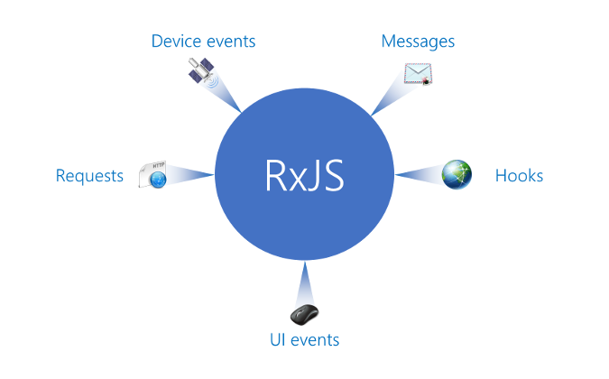
REACTIVE PROGRAMMING
ALL is a Stream
Programming paradigm where
is treated as a data stream
that propagates changes
ALL

Slide 29
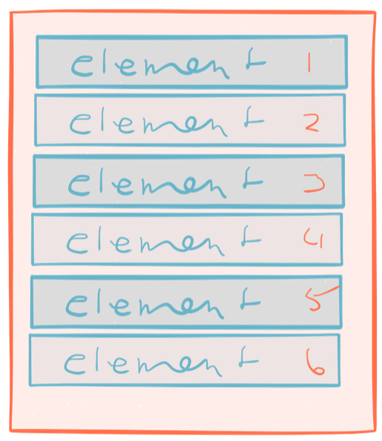
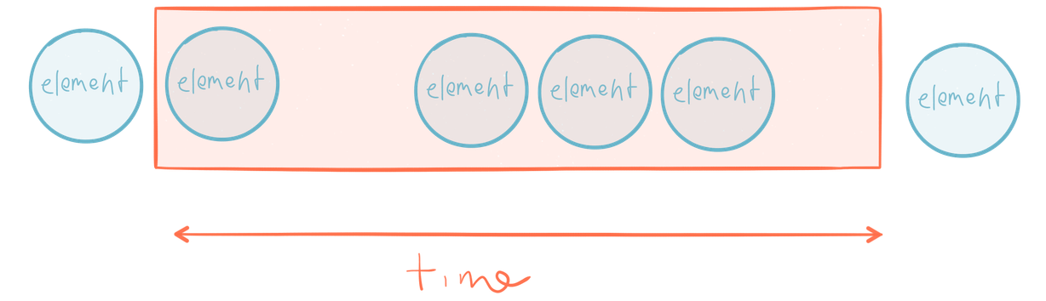
REACTIVE PROGRAMMING
Stream
Streams are a series of elements emitted over time
No!
But, isn’t it an Array?
Arrays have beginning and an end
A Stream has no beginning and no end

Slide 30
Stream Representation
REACTIVE PROGRAMMING
Time
Events represented by some value
Error
This indicates the Observable
has completed

Slide 31
REACTIVE PROGRAMMING
Limitations before Reactive Programming (1)
Frontend programs fire thousands of events, which need to be prepared to handle them effectively
This creates two important challenges: scalability and latency
With events we can get the known 6 plagues of listeners:
Unpredictable order
Missed first event
Messy state
Threading issues
Leaking callbacks
Accidental recursion

Slide 32
REACTIVE PROGRAMMING
Limitations before Reactive Programming (2)
Main problem in frontend development: Blocking code
Non-blocking code with callback functions
Callbacks cannot solve the temporal dependency
Callback Hell
Alternatives?
Event emitters
Promises

Slide 33
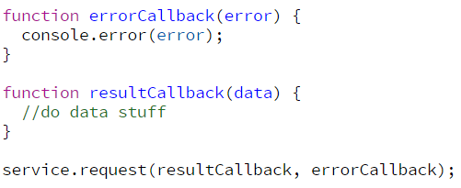
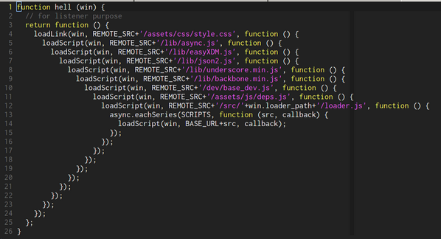
REACTIVE PROGRAMMING
Callback Hell
So far, so good!!
Callback Hell

Slide 34
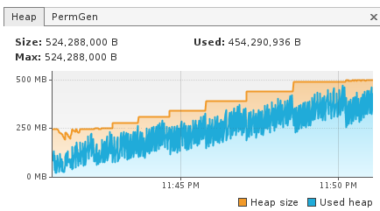
REACTIVE PROGRAMMING
Event emitters
element.addEventListener(‘keyup’, keyupHandler);
function keyupHandler(e: KeyboardEvent) {
//do some stuff
}
Memory leaks

Slide 35
REACTIVE PROGRAMMING
Promises
Cannot handle more than one result
Cannot retry from failure
Cannot be cancelled

Slide 36
REACTIVE PROGRAMMING
Reactive Programming
Resolve all problems described above and more:
Focuses on propagating changes without having to explecity how the propagation happens
Event-based
All is viewed as a flow of data, instead of the traditional flow control
Abstracts out the notion of latency because we can model solutions using a sequence of steps
Powerful composition and aggregation of streams
Good fit for concurrent and event-driven systems
Easy to test

Slide 37
REACTIVE PROGRAMMING
Generator
Stream
Multiple
Synchronous
Asynchronous
Function
Promise
Single

Slide 38
REACTIVE PROGRAMMING
Pull vs Push
Data
PULL
Transform
data
update

Slide 39
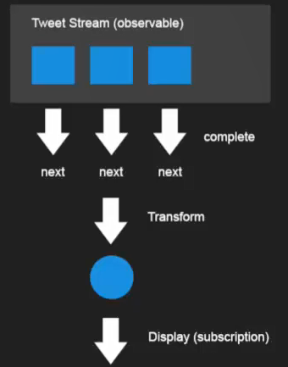
REACTIVE PROGRAMMING
Pull vs Push
PUSH

Slide 40
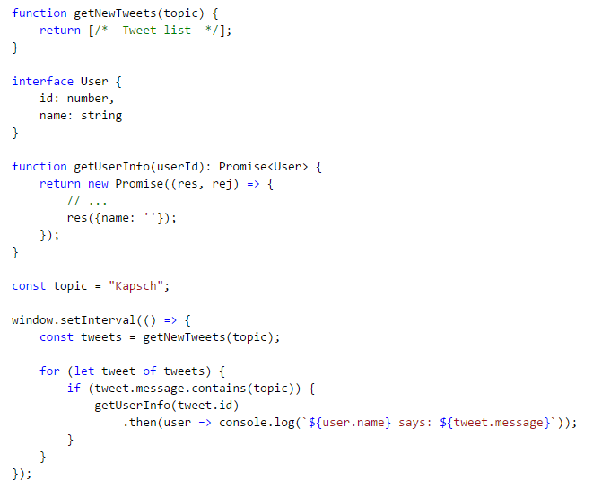
REACTIVE PROGRAMMING
Pull vs Push
Get Tweets
PULL

Slide 41
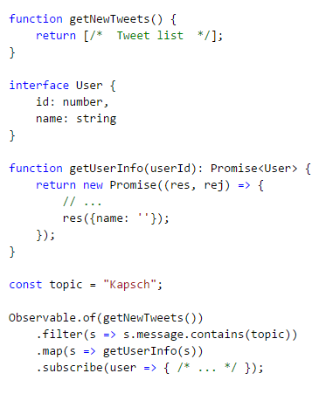
REACTIVE PROGRAMMING
Pull vs Push
Get Tweets
PUSH

Slide 42
Functional Reactive Programming

Slide 43
FUNCTIONAL REACTIVE PROGRAMMING
FRP
is a specific programming technique to improve your code in an area that just happens to be a common source of complexity (and therefore bugs): event propagation
Enforces the rules of functional programming, particularly the property of compositionality and aggregation of streams
makes your code cleaner, clearer, more robust, and more maintainable, in a word, simpler
is a very different way of doing things. It will improve your code and transform your thinking for the better
Good fit for concurrent and event-driven systems
Easy to test

Slide 44
FUNCTIONAL REACTIVE PROGRAMMING
The main benefit of FRP
Deals with complexity,
enforcing compositionality
reaches no side effects

Slide 45

FRP Requires a
paradigm shift
Notes:
Barney definition on click

Slide 46
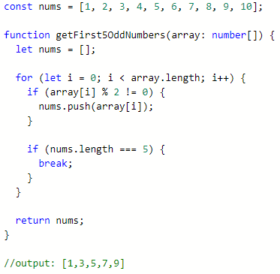
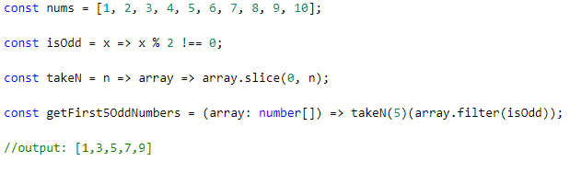
FUNCTIONAL REACTIVE PROGRAMMING
Paradigm shift: WHY?
IMPERATIVE WAY
DECLARATIVE WAY
The code describes the order to get the result:
Determines HOW TO DO things
Defines the operations,
but doesn’t defines the flow control
Determines WHAT TO DO, not HOW

Slide 47
FUNCTIONAL REACTIVE PROGRAMMING
FRP Core concepts
- The Observable object represents a push based collection. It emits values over the time.
- The Observer and Observable interfaces provide a generalized mechanism for push-based notification (Observer design pattern):
Observable: represents the object that sends notifications (the provider)
Observer: represents the class that receives them (the observer)
Observables
Operators
Each operator in the chain modifies the Observable that results from the operation of the previous operator
Subscriptions
Represents a disposable resource, such as the execution of an Observable

Slide 48
FRP Core concepts
FUNCTIONAL REACTIVE PROGRAMMING
Observables
PIPELINE
Operators
Subscriptions

Slide 49
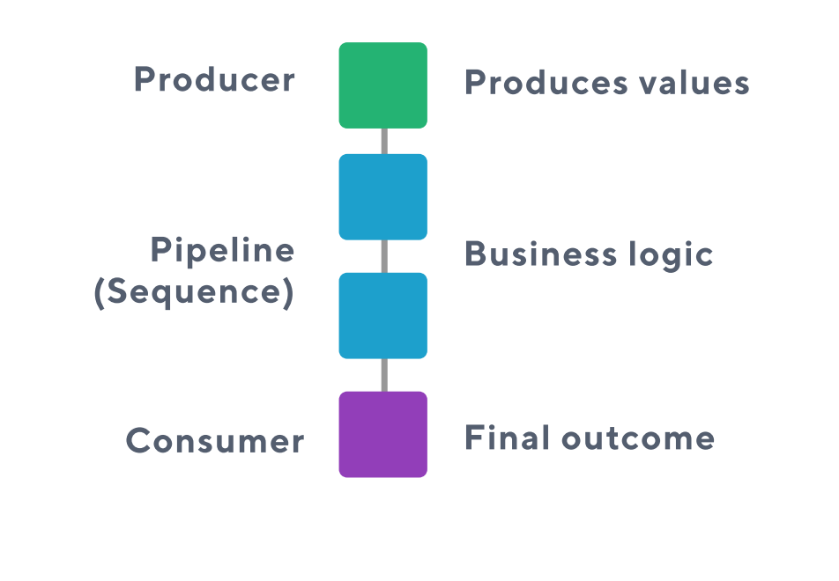
Global idea
FUNCTIONAL REACTIVE PROGRAMMING
Global Idea
OBSERVABLE

Slide 50
Global idea
FUNCTIONAL REACTIVE PROGRAMMING
Global Idea
OPERATORS

Slide 51
Global idea
FUNCTIONAL REACTIVE PROGRAMMING
Global Idea
SUBSCRIPTION

Slide 52
Let’s looking them up in depth…

Slide 53
FUNCTIONAL REACTIVE PROGRAMMING
OBSERVABLE

Slide 54
Global idea
FUNCTIONAL REACTIVE PROGRAMMING
Observable
Represents a sequence of values over time
Is asynchronous
Is Lazy
To get values out, you have to subscribe to it

Slide 55
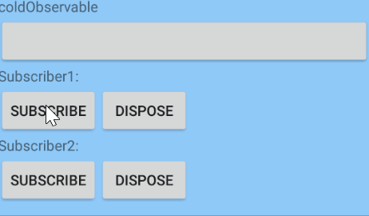

Observable
FUNCTIONAL REACTIVE PROGRAMMING
Types
Cold observable
Hot Observable
Starts running upon subscription: only pushes values to the observers when subscribe method is called
Emits immediately whether its Observer is ready or not and regardless of subscribers
Every observer can see whole stream
Is shared among all subscribers, and each subscriber is pushed the next value in the sequence
Examples:
Service Request
Reading file
Examples:
Mouse events
Video streaming

Slide 56
FUNCTIONAL REACTIVE PROGRAMMING
OPERATORS

Slide 57
Global idea
FUNCTIONAL REACTIVE PROGRAMMING
Operators
Allow us to spawn sequences of asynchronous requests taking advantage of pure functions to keep all of the information properly scoped
Allow us to manipulate or edit the data passing it from the producer to the consumer (pipeline):
we can adapt the output of the producer to match the expectations of the consumer
promotes a separation of concerns
This design principle is typically extremely hard to accomplish in large-scale JavaScript applications, but RxJS facilitates this model of design

Slide 58
Global idea
FUNCTIONAL REACTIVE PROGRAMMING
Operators
Categories
- CREATION
- TRANSFORMATION
- FILTERING
- COMBINATION
- ERROR HANDLING
- CONDITIONAL
- BACK PRESSURE
- CONNECTION
- UTILITY

Slide 59
Global idea
FUNCTIONAL REACTIVE PROGRAMMING
Operators
Marble Diagrams

Slide 60
Global idea
FUNCTIONAL REACTIVE PROGRAMMING
Operators
Example
Observable.fromEvent(input, ‘keyup’)
We want to take the first two numbers from a text input
.map(event => event.key)
.filter(Number)
.take(2)
.subscribe(console.log);
Elm street 13
1
3

Slide 61
Operators that you may know

Slide 62
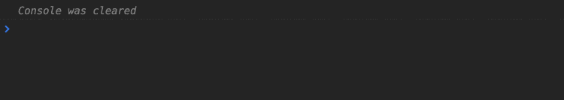
Concat
FUNCTIONAL REACTIVE PROGRAMMING
Subscribe to Observables in order but only when the previous completes, then move to the next one

Slide 63
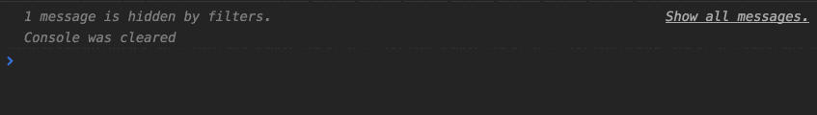
mergeMap
FUNCTIONAL REACTIVE PROGRAMMING
Only when the inner Observable emits, let me know by merging the value to the outer Observable

Slide 64

switchMap
FUNCTIONAL REACTIVE PROGRAMMING
Like mergeMap but when the source Observable emits cancel any previous subscriptions of the inner Observable

Slide 65
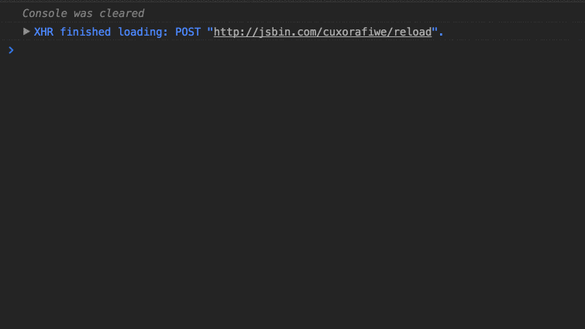
combineLatest
FUNCTIONAL REACTIVE PROGRAMMING
Let me know when any Observable emits but also give me the latest value from the others

Slide 66
FUNCTIONAL REACTIVE PROGRAMMING
SUBSCRIPTIONS

Slide 67
Global idea
FUNCTIONAL REACTIVE PROGRAMMING
Subscriptions
A subscription is the consumer of an observable, using an observer.
Calling subscribe() on an observable source, returns a Subscription object

Slide 68
FUNCTIONAL REACTIVE PROGRAMMING
Mind map
next( )
Observable
Observer
.subscribe()

Slide 69







Example
FUNCTIONAL REACTIVE PROGRAMMING

Slide 70
FUNCTIONAL REACTIVE PROGRAMMING
const hotWater$ = Observable.from(water)
.switchMap(heatWater);
hotWater$.switchMap(addTea)
.delay(30sec)
.subscribe(teaConsumer);
const coffee$ = hotWater$.switchMap(addBeans);
coffee$.subscribe(coffeeConsumer);
coffee$.switchMap(addMilk)
.subscribe(cafeLatteConsumer);

Slide 71
FUNCTIONAL REACTIVE PROGRAMMING
Always
unsubscribe

Slide 72
Global idea
FUNCTIONAL REACTIVE PROGRAMMING
Unsubscribe
retrieveData() { this.dataSubscription = Observable.interval(60000) .map(_ => this.getData()) .subscribe(data => this.updateData(data)); this.refreshSubscription = Observable.fromEvent(cancelBtn, ‘click’) .subscribe(() => this.updateData(data)); } destroySubscriptions() { this.dataSubscription.unsubscribe(); this.cancelSub.unsubscribe(); }
A subscription is like an “event listener”
If don’t release the subscription, we are generating memory leaks
Keeping too many subscriptions around is a sign of don’t understand RP
Use .unsubscribe()

Slide 73

FUNCTIONAL REACTIVE PROGRAMMING
Don’t unsubscribe

Slide 74
Global idea
FUNCTIONAL REACTIVE PROGRAMMING
Don’t Unsubscribe
Keeping subscriptions around is a sign we are managing subscriptions imperatively
Every subscription have to be disposed, but…
We can do that using some operators as well

Slide 75
Global idea
FUNCTIONAL REACTIVE PROGRAMMING
Don’t Unsubscribe: operators that complete streams
Example: take(n)
emits N values before stopping the observable
get10FirstTweets() { Observable.of(httpClient.getTweets()) .take(10) .subscribe(tweets => this.displayTweets(tweets)); }

Slide 76
Global idea
FUNCTIONAL REACTIVE PROGRAMMING
Don’t Unsubscribe
More auto-unsubscribe operators
takeUntil
takeWhile
first()
first(predicate)
…

Slide 77
FUNCTIONAL REACTIVE PROGRAMMING
Backpressure

Slide 78
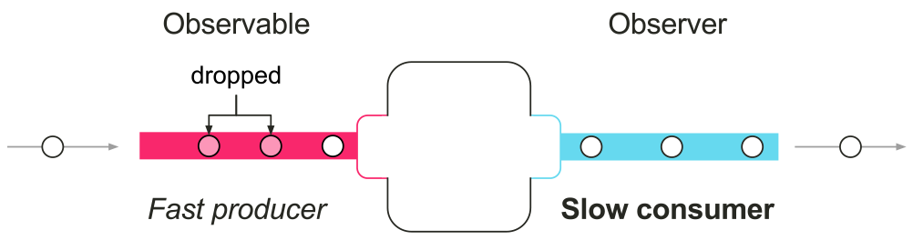
Global idea
FUNCTIONAL REACTIVE PROGRAMMING
Backpressure
Complex problem caused when a quickly-producing Observable meets a slow-consuming observer
RxJS has operators to control that problem:

Slide 79
Global idea
FUNCTIONAL REACTIVE PROGRAMMING
Backpressure
Complex problem caused when a quickly-producing Observable meets a slow-consuming observer
RxJS has operators to control that problem:
buffer
bufferWithCount
bufferWithTime
bufferWithTimeOrCount
periodically gather items emitted by an Observable into bundles and emit these bundles rather than emitting the items one at a time

Slide 80
Global idea
FUNCTIONAL REACTIVE PROGRAMMING
Backpressure
debounce
debounceTime
only emit an item from an Observable if a particular timespan has passed without it emitting another item

Slide 81
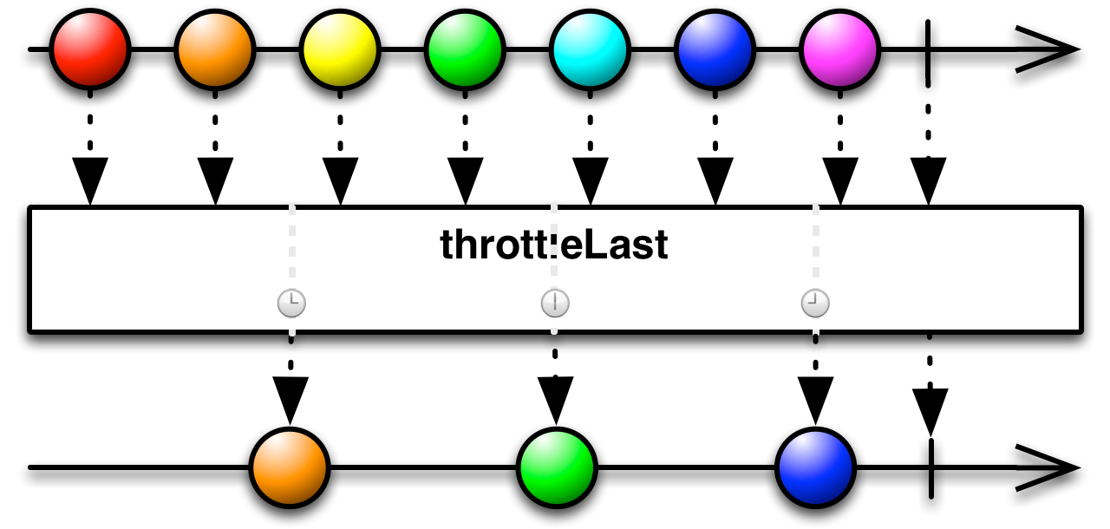
Global idea
FUNCTIONAL REACTIVE PROGRAMMING
Backpressure
throttle
throttle Time
Emit latest value when specified duration has passed

Slide 82
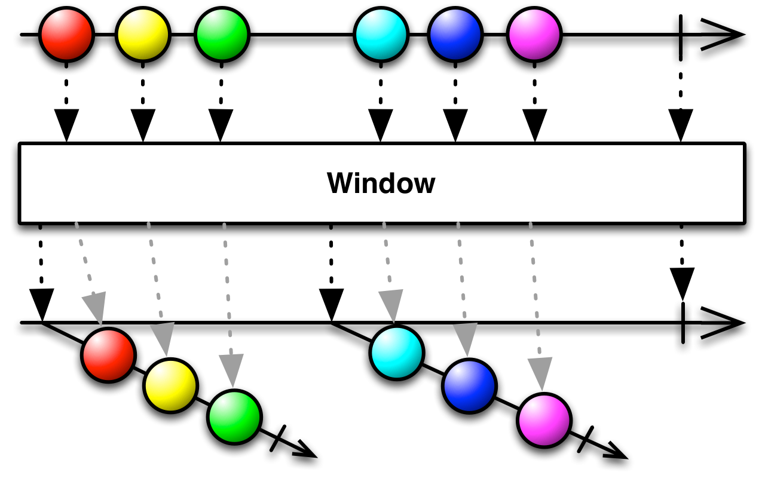
Global idea
FUNCTIONAL REACTIVE PROGRAMMING
Backpressure
window
windowTime
windowToogle
windowCount
windowWhen
periodically subdivide items from an Observable into Observable windows and emit these windows rather than emitting the items one at a time

Slide 83
FUNCTIONAL REACTIVE PROGRAMMING
Error Handling

Slide 84
Global idea
FUNCTIONAL REACTIVE PROGRAMMING
Imperative techniques
try / catch:
Imperatively you need to “restore” the flow execution
Ugly and incomprehensible code
Controlling errors with callbacks:
We need nested sequences in case of failure

Slide 85
Global idea
FUNCTIONAL REACTIVE PROGRAMMING
The reactive way of dealing with failure
Errors are propagated downstream to observers
We can catch the errors and react accordingly
We can retry a failed operation for a fixed number of times
We can react to a failed retries

Slide 86
Global idea
FUNCTIONAL REACTIVE PROGRAMMING
Error managing operators
catch
retryWhen
Other operators…
onErrorResumeNext
retry(n)
finally

Slide 87
FUNCTIONAL REACTIVE PROGRAMMING
With an Observable we represent a data source,
but we cannot do neither
.next(), .complete() nor .error() !!??
I need more control…

Slide 88
FUNCTIONAL REACTIVE PROGRAMMING
Subjects to the rescue!!

Slide 89
Subjects
FUNCTIONAL REACTIVE PROGRAMMING
Subject-Observer design pattern:
Inherit from Observer and Observable, and are hot by definition
Have next, complete and error methods
Can act as a proxy for a group of subscribers and a source
Are not reusable: when a Subject completes or errors, it can no longer be used, it will silently
ignore the future notification.
Diferent types: AsyncSubject, ReplaySubject, BehaviorSubject, …

Slide 90
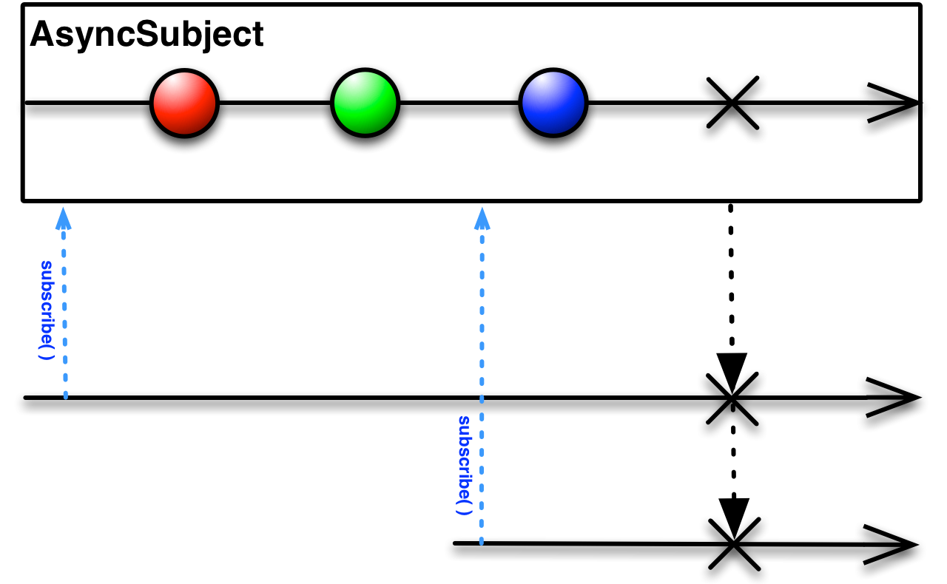
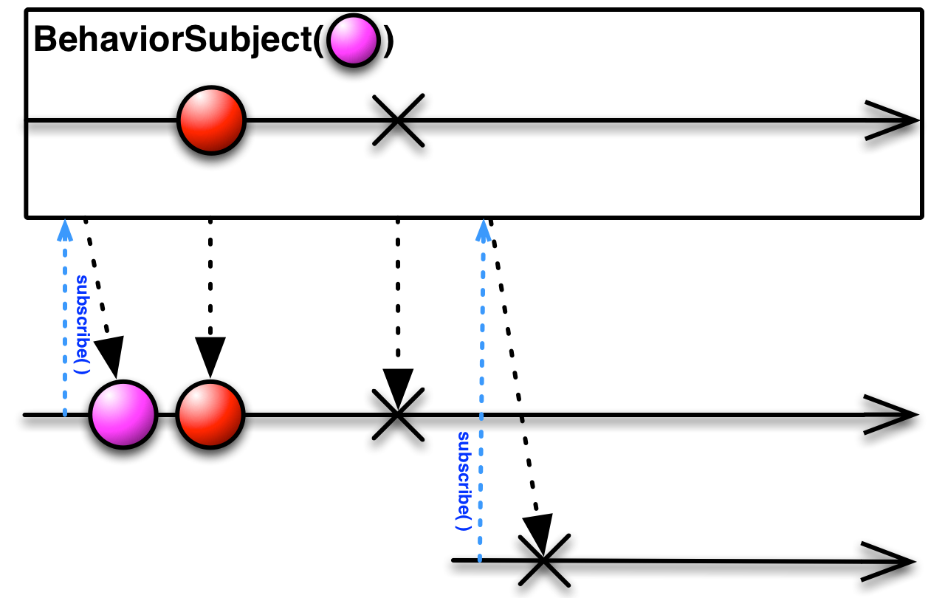
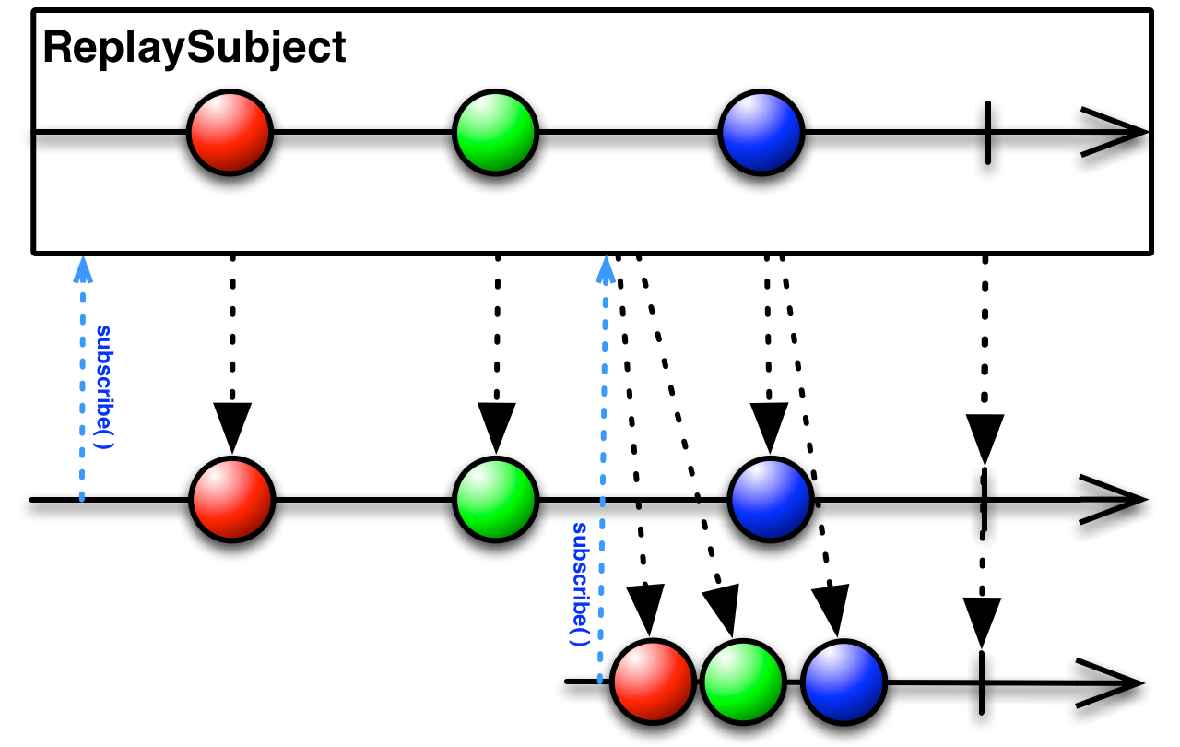
Subjects
FUNCTIONAL REACTIVE PROGRAMMING
TYPES

Slide 91
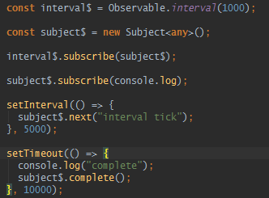
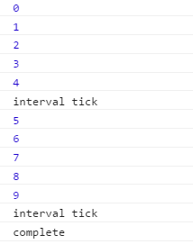
Subjects
FUNCTIONAL REACTIVE PROGRAMMING
Subject as an observer
Able to stop receiving values

Slide 92
FRP
Exercises

Slide 93
QA?

